Slide 1
Lammps @ Sc22
National tsing hua university @ sc22

Slide 2
outline
Running multiple CPU processes per 1 GPU
Using Intel package on AMD nodes
Comparison between NGC and Compile from source
Hyperthreading of AMD vs Intel
Scalability on Oracle Cloud Infrastructure
Comparison between GPU acceleration package and KOKKOS package

Slide 3
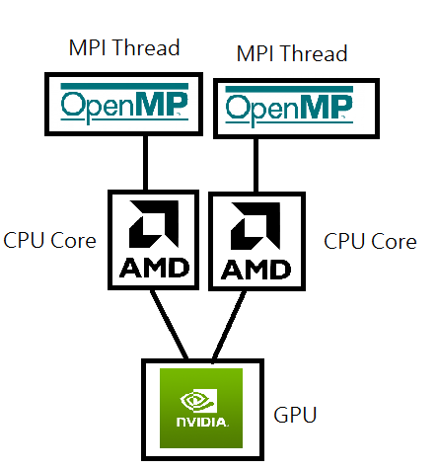
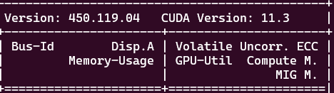
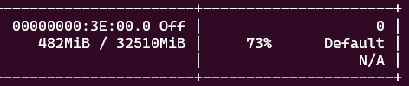
Gpu under utilization & procs per gpu

Slide 4
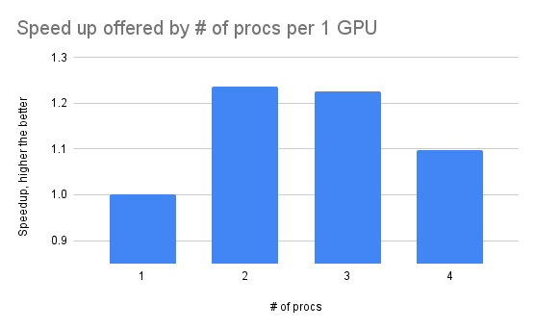
Interpretation & strategy
Use 2 procs per GPU
+25%

Slide 5


Intel package @ amd cluster
80
70
3x faster
60
30
20
2
Intel pkg accelerates AMD nodes !!!

Slide 6

Interpretation & strategy
Uses vectorization of Intel (AVX, SSE) to speedup
AMD also supports vectorization (SSE) for speedups
Use Intel Package to speedup our AMD cluster

Slide 7
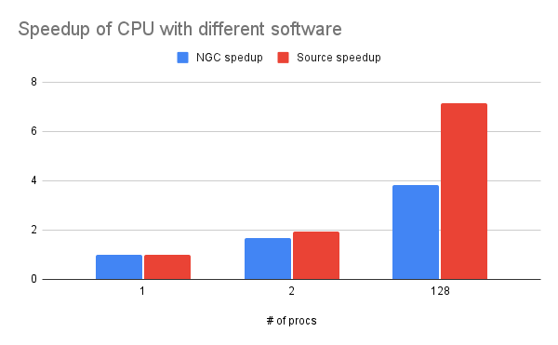

NGC & Compile from source @ CPU
80
70
+36%
55

Slide 8
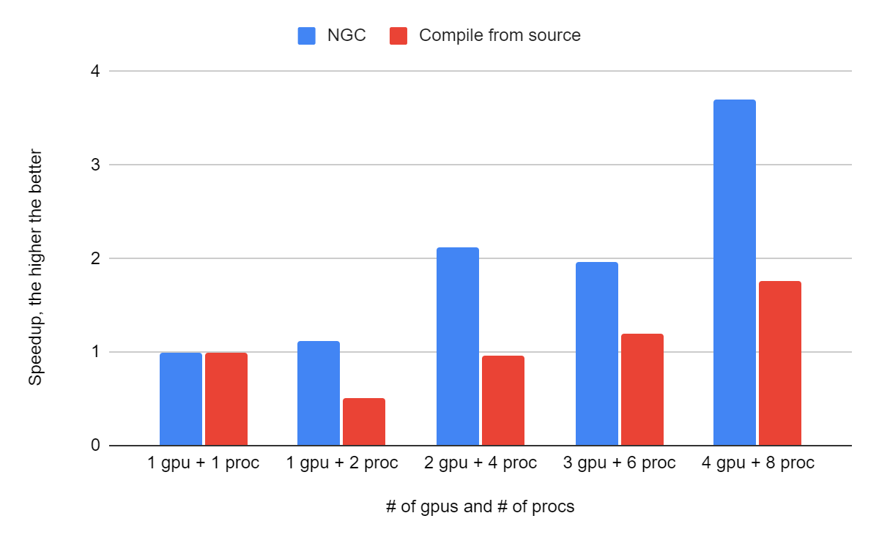
NGC & Compile from source @ GPU
4 GPUs offers 3.8x speedup

Slide 9
Strategy & interpretation
Problem size | Hardware | Software
Small problem | 1 GPU | Compile from source
Medium problem | 2 GPUs w/ NvLink | NGC
Big problem | 4 GPUs w/ NvLink | NGC
All problems | CPU | Compile from source
NGC incurs overhead due to virtualization
Compile from source always works better on CPU

Slide 10
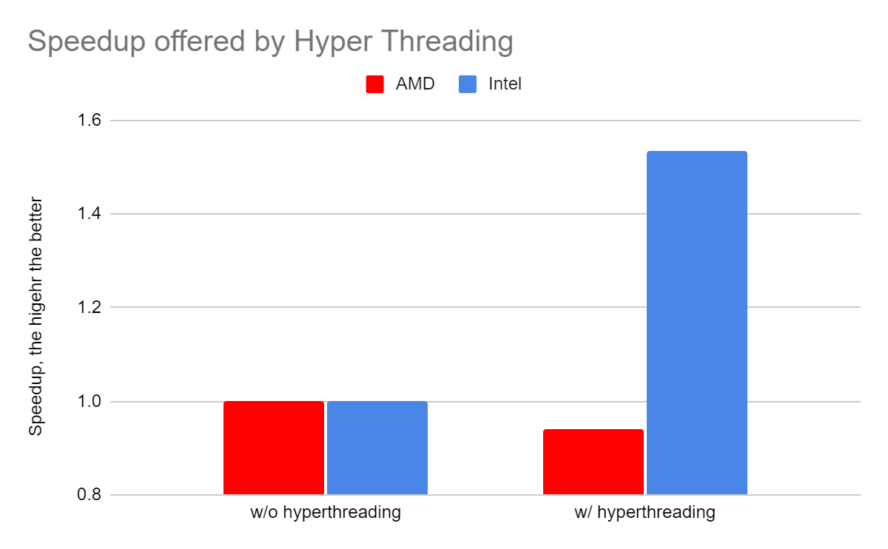
Hyperthreading @ amd, intel
Use HT on Intel only
Intel HT > AMD HT
65% of differences

Slide 11
OCI scalability
OCI nodes are connected by ethernet
Run intranode task for OCI only
Communication overhead is significant
-25% performance

Slide 12
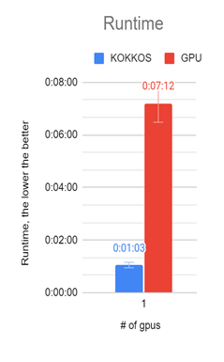
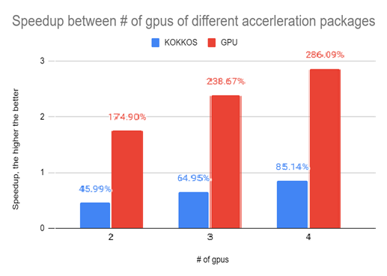
Kokkos and gpu
7x of runtime

Slide 13
Interpretation & strategy
 | GPU | KOKKOS
Purpose | General purpose | Specific purpose
Hardware | NV, Intel, AMD, OpenGL | Nvidia, Intel Phi
Scalability | ✓
Absolute speed |  | ✓
Special hardware support |  | ✓
Personal clusters = Nvidia GPU
Use KOKKOS

Slide 14
Lennard jones & eam & ml-snap
Benchmarks | GPU node | CPU node | Potential model
Lennard Jones | ✓ | ✓ | Mathematics
EAM | ✓ | ✓ | Mathematics
ML-Snap | ✓ |  | Machine Learning

Slide 15
Interpretation & Strategy
Machine learning requires tensor operations
Better for GPU nodes
GPU provides numerous CUDA cores for tensor operations
Don’t put ML-Snap tasks on CPU nodes

